Slide 1
Smart, Inclusive & Sustainable Growth: Standortpolitik or the Strategic Management of Place
David B. Audretsch

Slide 2
“The value of any commodity, therefore, to the person who possesses it, and who means not to use or consume it himself, but to exchange it for other commodities, is equal to the quantity of labour which it enables him to purchase or command. Labour, therefore, is the real measure of the exchangeable value of all commodities. The real price of everything, what everything really costs to the man who wants to acquire it, is the toil and trouble of acquiring it.” ― Adam Smith, The Wealth of Nations

Slide 3
Innovation Policy
“Innovation policy is about helping companies to perform better and contributing to wider social objectives such as growth, jobs and sustainability.”
European Commission, 2012

Slide 4
Industrial Policy
“Industrial Policy means the initiation and coordination of governmental activities to leverage upward the productivity and competitiveness of the whole economy and of particular industries in it. Above all, positive industrial policy means the infusion of goal-oriented, strategic thinking into public economic policy…In more abstract terms, industrial policy is the logical outgrowth of the changing concept of comparative advantage.”
--Chalmers Johnson, The Industrial Policy Debate, 1984

Slide 5
“I would also like to point out that it is not just new thinking that we need. Rather, it is often equally important to recall older ideas and approaches that may have fallen out of the limelight in the meantime. For example, we in Germany have sharpened our focus on the necessity of pursuing economic and fiscal policies that are consistent with the principles of markets and competition -- what we call Ordnungspolitik. This approach can make crucial contributions to the concrete design of policies and especially institutions. In my view, Germany's "debt brake" is an institution that lays the groundwork for reliable long-term policymaking and that by itself can counteract undesirable fiscal and economic developments.”
Wolfang Schäuble, Minister of Finance

Slide 6
Ordnungspolitik
Establishment of rules and legal framework for the economy
Ordnungspolitik is commonly known as legal actions by the government, establishing a framework for the economy which ensures the sustainment, adjustment and improvement of the economic order
(Schubert, Klaus/Martina Klein, Das Politiklexikon, 4. Aufl., 2006)

Slide 7
Mission of Ordnungspolitik
Ordnungspolitik creates a framework wherein market mechanisms are enabled and aims at the prevention of the concentration of economic power
Configuration of property rights
Rules to ensure economic competition (Wettbewerbsrecht – ban of cartels, collusion, etc.; control of marketing and sales processes)
Configuration of contracts (Vertrags- und Haftungsrecht)
Alfred Schüller / Hans-Günter Krüsselberg (Hg.): Grundbegriffe zur Ordnungstheorie und Politischen Ökonomik. 6. durchgesehene und ergänzte Auflage, Marburg 2004.

Slide 8
Ordnungspolitik as a Strategy of Economic Policy
Concepts of economic policy as the ordoliberalism define Ordnungspolitik as the most important task towards developing economic policy
The government should mainly take care of the composition of economic order
The economic processes should be regulated mainly by market mechanisms
The economic system of the social market economy includes Ordnungspolitik and Prozesspolitik in its economic policy
Gabler Verlag (Herausgeber), Gabler Wirtschaftslexikon, Prozesspolitik

Slide 9
Institutional Foundations of Ordnungspolitik
Sozialmarkt (Social Market Economy) means investments in people, industry and stability
Co-Determination (Mitbestimmung) means unions involved in company policy
Consensus – Industry, Unions & Government make decisions based on negotiations & consideration of all interests
Alfred Müller-Armack: Soziale Marktwirtschaft in Handwörterbuch der Sozialwissenschaften, (1956)

Slide 10
Strukturpolitik
Strukturpolitik is a generic term for procedures that shape the structure of the national economy
Its goal is to prevent and overcome structural crises, which can disturb economic balance
Changes in the economy caused by new products, globalization and structural changes are weakened by the Strukturpolitik and made more compatible to the society
Strukturpolitik is implemented by:
Regional Strukturpolitik: measures promote investments that support the settlement of industries and firms
Strukturpolitik in industries: Funding and tax allowance…
… helping to sustain industries for political reasons (Erhaltungspolitik)
… facilitating the adjustment to structural changes (Anpassungspolitik)
… supporting the usage of modern technologies in advanced regions (Gestaltungspolitik)

Slide 11
Regulatory Reform & the Second German Economic Miracle

Slide 12
Increase in Employment, 2006-’12

Slide 13
Decline in Unemployment, ‘06-’12

Slide 14
Growth of Exports

Slide 15
Exports as Share of GDP

Slide 16
The Regulatory Reforms of 2004
Agenda 2010
Hartz IV for unemployed – incentives for employment
Flexibility in labor regulations
Educational reforms
Increased commitment to science & R&D
Enabling entrepreneurship

Slide 17
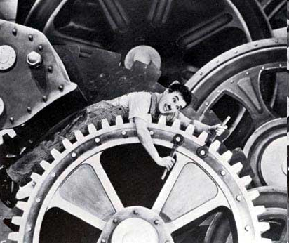
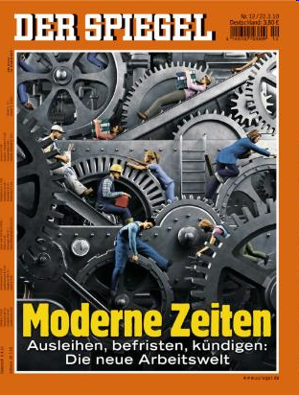
Modern Times

Slide 18
Increased Investment in R&D

Slide 19
The Knowledge Filter

Slide 20
New Entrepreneurship Policy in Germany
Subsidies for start-ups (financing and consulting)
Loans, sureties, equity capital financing for establishing a new business
Service points (information)
Programs issued on all levels of government – national, Laender & local

Slide 21
Entrepreneurship Policies
Microcredit Program (Förderkredite)
KfW Mittelstandsbank (10.000 -25.000€)
High Tech Startup Funds (Gründerfond)
500.000 € for seed finance (86% from Gov’t, co-investment with V.C.)
EXIST –University Based Startups
Culture of Entrepreneurship
Startup Grants (30.000 € annually)
Transfer & Commercialization of Research (50.000 € in Phase I; 150.000 € in Phase II)

Slide 22
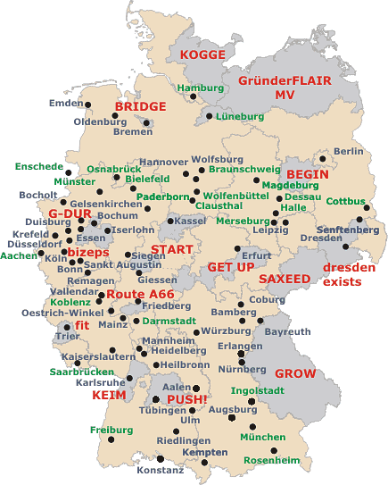
Support of the Ministry of Research and Education
BMBF program to promote regional support infrastructures for university-based start-ups
15 (5) Exist regions and
Partnership regions

Slide 23
Standortpolitik
Standortpolitik is part of economic policy
Standortpolitik refers to the market based choice of a location, where a company uses production factors to produce goods and services
The factors influencing the market based decision of location are called Standortfaktoren

Slide 24
The Strategic Management of Places
Factors & Resources
Spatial Structure & Organization
Human Dimension
Policy

Slide 26
Factors & Resources
Natural Resources
Physical Capital
Infrastructure
Knowledge Capital, Human Capital, Creativity, Skilled Labor

Slide 27
Human Dimension
Networks, linkages & interactions – social capital
Leadership

Slide 28
Policy
Institutions
Absorptive capacity mechanisms
Capabilities
Global benchmarking

Slide 29
Spatial Structure & Organization
Specialization
Diversification
Market Power
Localized Competition
Entrepreneurship
Global Linkages

Slide 30
Conclusions
Strategic Management of a Place enhances Smart, Inclusive and Sustainable Growth
Distinguishes between local economy & global markets
Generates superior economic performance of Standort in global economy
Myth of de-regulation – modified or recalibrated regulation responsible for improved performance

